Slide 1
Convergence of compositional task structure in humans and artificial neural networks

Slide 2
Central question
Do human and artificial neural networks (ANNs) use the same computational strategies to perform compositional tasks?
Specific questions:
ANNs can solve tasks in a multitude of ways. Do ANNs that learn tasks compositionally exhibit similar behaviors to human behavior?
Do ANNs that learn tasks compositionally exhibit similar internal representations to human brain representations?

Slide 3
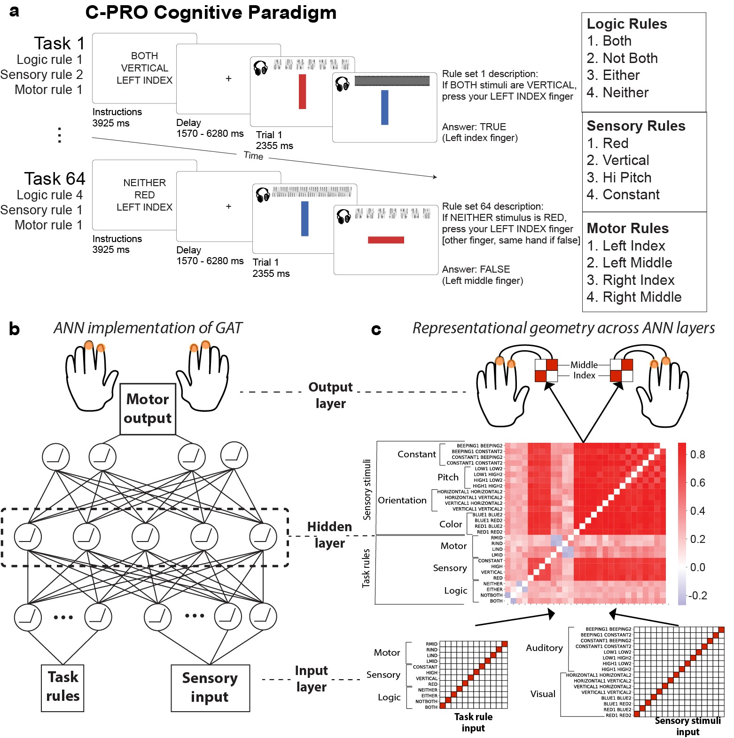
Task – Concrete Permuted Rule Operations (C-PRO)

Slide 4
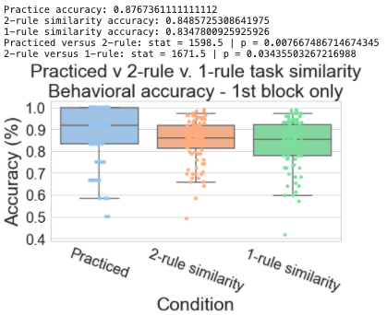
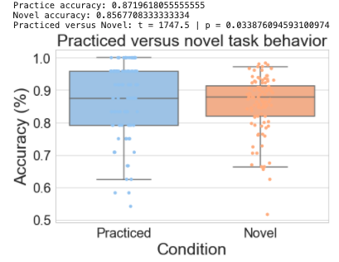
Evidence for compositionality in human behavior

Slide 5
Analysis 1 - ANN
Build a model to perform the CPRO task
Train the model on 4 practiced tasks
Evaluate model performance on novel tasks, varied by task similarity
Does the ANN exhibit similar compositional behaviors to humans?

Slide 6
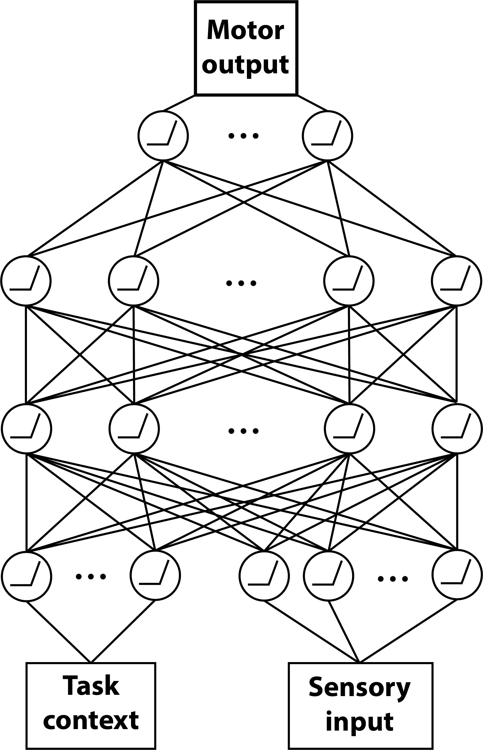
Model architecture
4 units
256 units
256 units
11 (context) + 16 (sensory) units

Slide 7
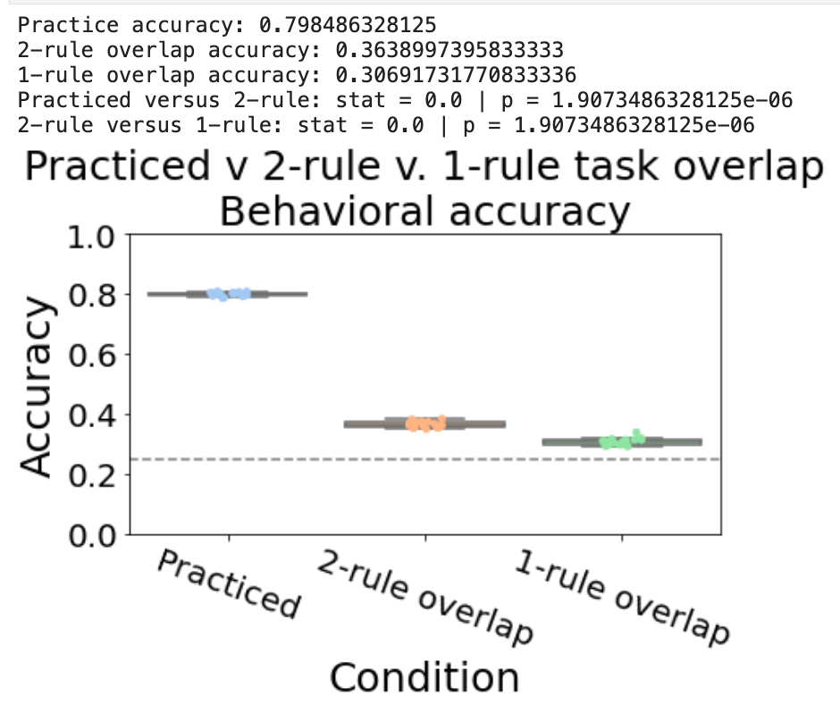
Train model on 4 tasks
Accuracy is close to chance levels on unseen ‘novel’ tasks
Practice training stops when network achieves 80% accuracy)

Slide 8
Analysis 2 - ANN
Build a model to perform the CPRO task
Pretrain the model on simplified tasks (e.g. task components) + 4 practiced tasks
Two simplified tasks:
Sensorimotor task:
If RED press LEFT MIDDLE
If VERTICAL press RIGHT INDEX
Logical-sensory tasks
If BOTH RED -> TRUE/FALSE
If NEITHER VERTICAL -> TRUE/FALSE
Intuition: pretraining on simple tasks forces network to have compositional structure

Slide 9
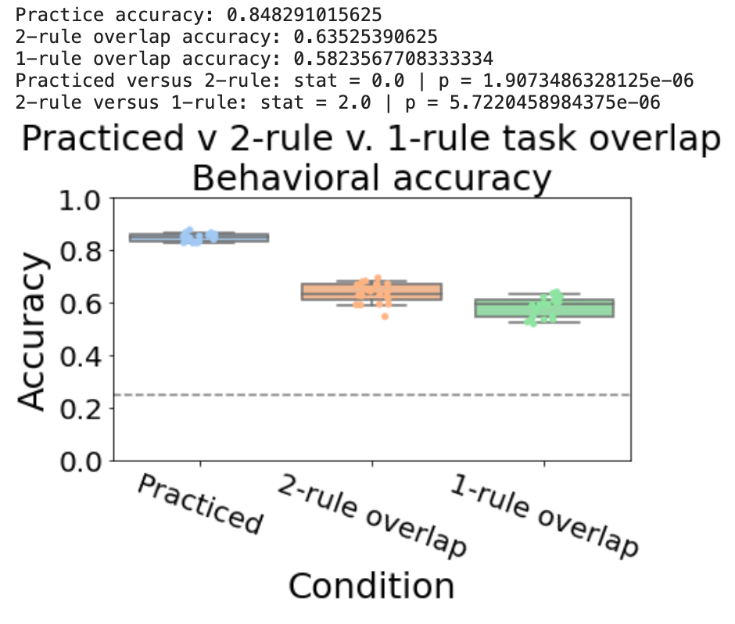
Evidence for compositionality Accuracy significantly improves on novel tasks (Practice training stops when network achieves 80% accuracy)

Slide 10
Analysis 2 - ANN
Model appears to reuse learned components to that enables it to generalize and perform novel tasks significantly above chance

Slide 11
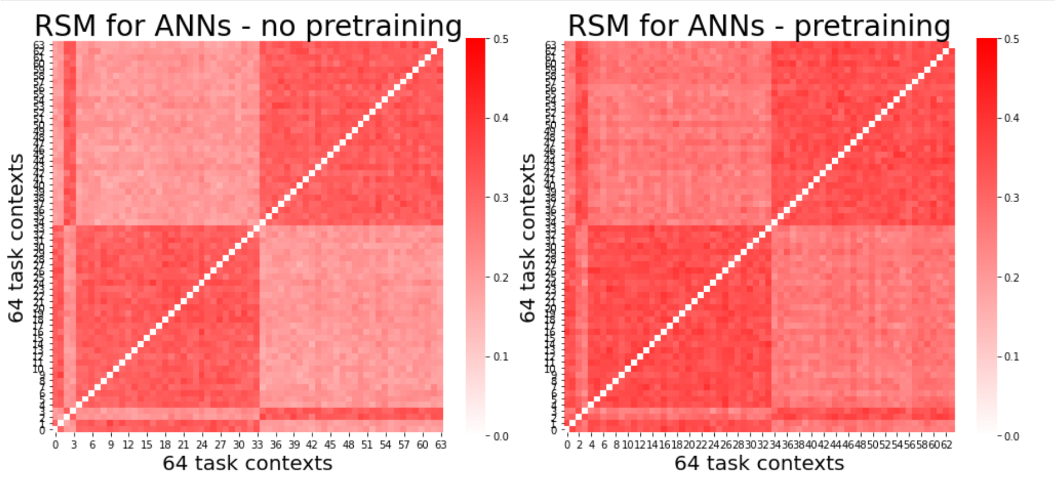
Do pretrained, compositional ANNs have more efficient (lower dimensional) representations?

Slide 12
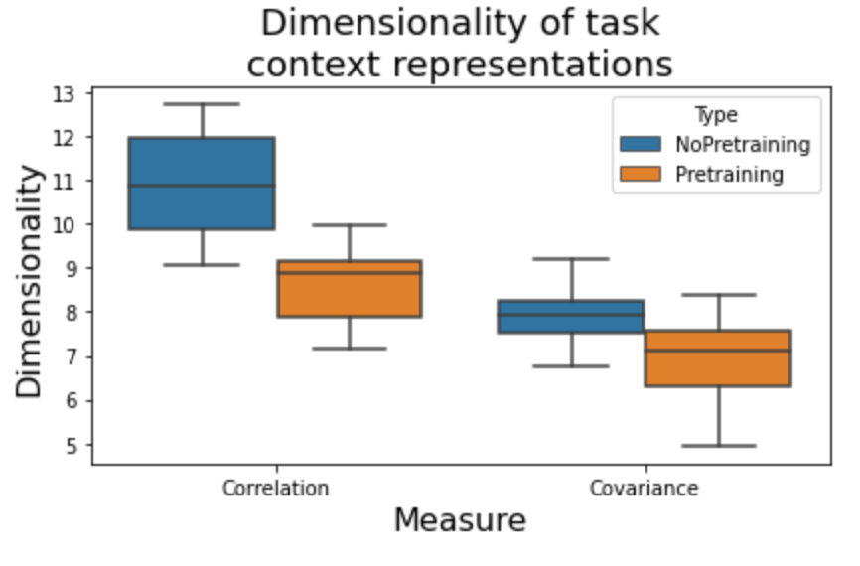
Do pretrained, compositional ANNs have more efficient (lower dimensional) representations?

Slide 13
What is the benefit of compressed, lower dimensional representations of the task context?
Do compressed context representations influence behavioral representations?

Slide 14
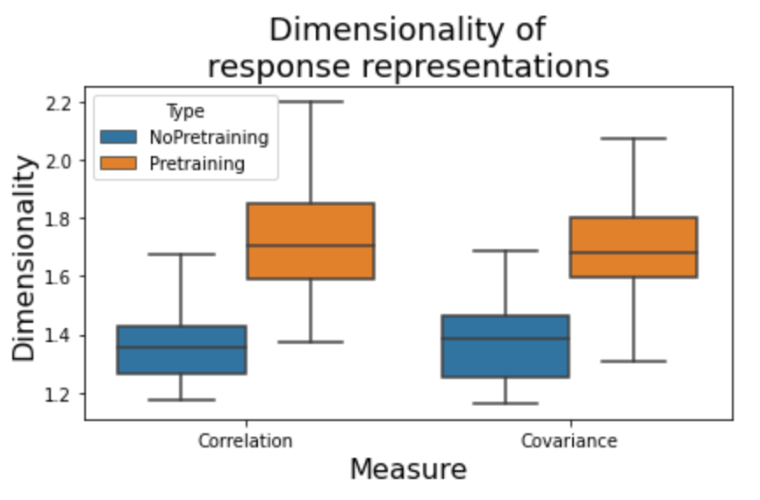
Do pretrained, compositional ANNs have higher dimensional behavioral representations (also have higher decoding accuracies)
Suggests abstract, compositional representations are useful for extracting relevant behavioral representations

Slide 15
Hypothesis / Prediction from model?
Makes 2 predictions: Increased compositionality leads to…
Improved behavioral representations for decoding
Lower dimensional context representations
Can be tested in empirical data by evaluating decodability of context and response (separately) as a function of rule presentation
*perhaps can serve as a hypothesis/explanation as to why PFC areas have such low decoding accuracies of context info

Slide 16
ANN experiment 2
Iteratively train networks on n practiced tasks, and test on 64 – n novel tasks
Tests for ‘one shot learning’
If networks are learning compositionally, they should likely improve performance as n increases
4 network types (all trained on 150 epochs)
ANN with pretraining (SGD)
ANN with pretraining (Adam)
ANN (SGD) – no pretraining
ANN (Adam) – no pretraining

Slide 17
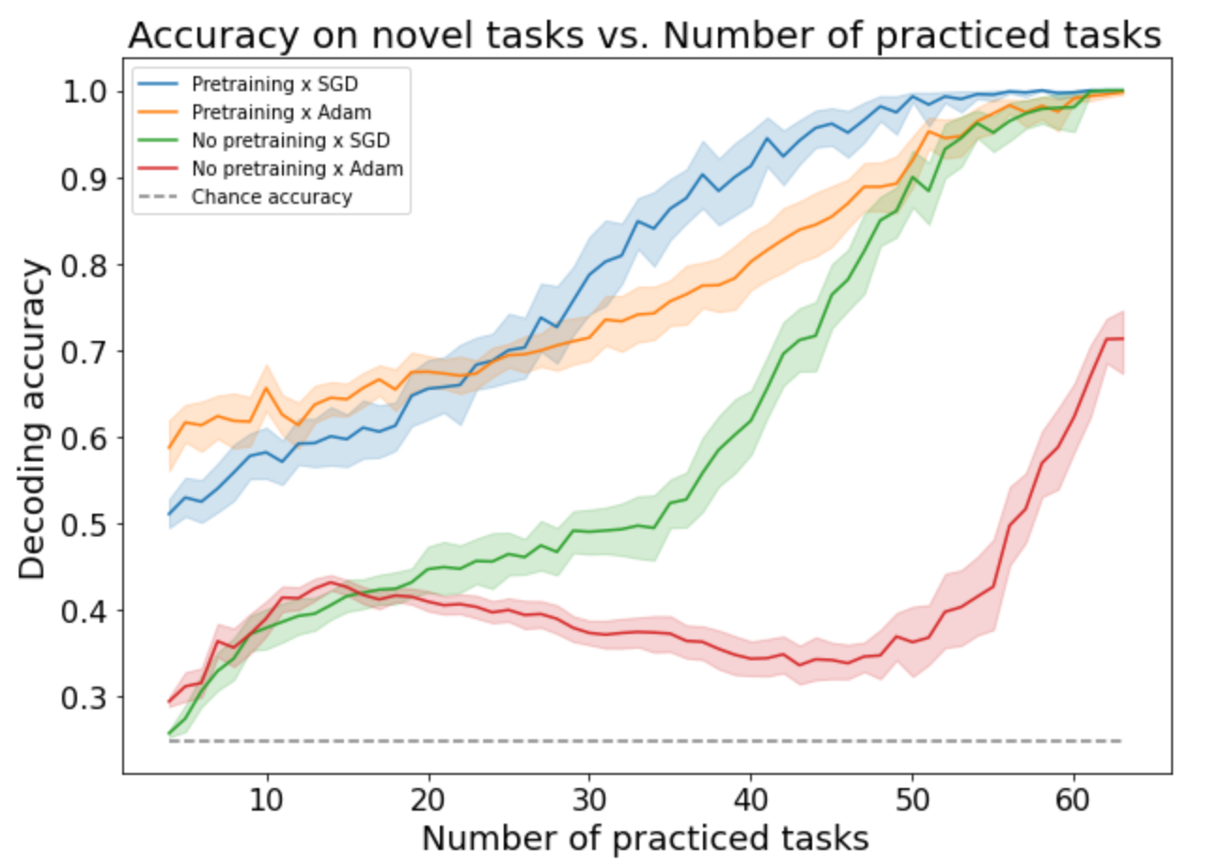
Pretraining significantly improves performance
Networks without pretraining cannot perform the task very well

Slide 18
Earlier hypothesis:
Lower dimensional task context representations
➔
Higher dimensional response representations
So, across training, does reduced context dimensionality correlate with response dimensionality?

Slide 19
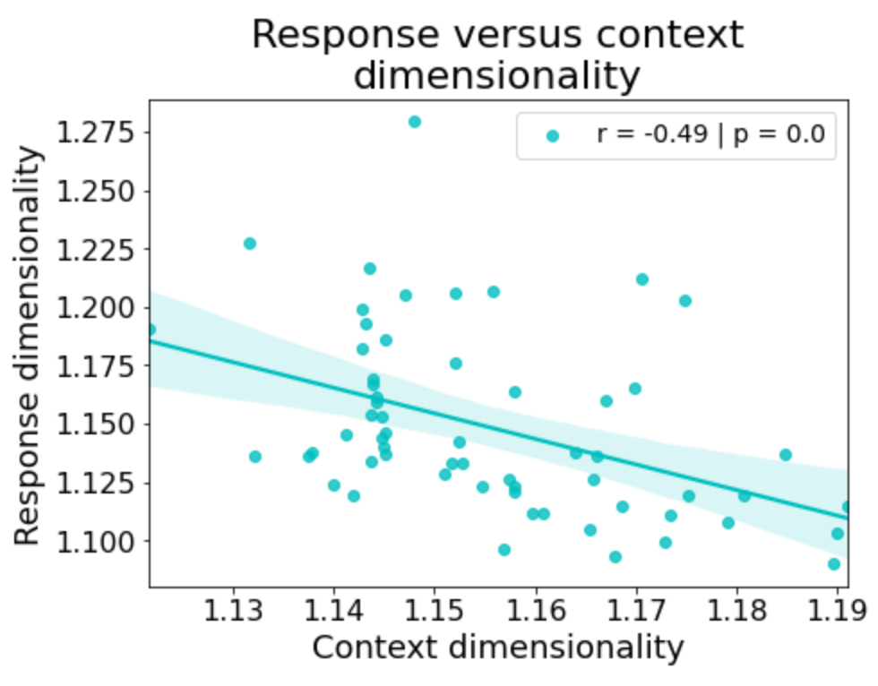
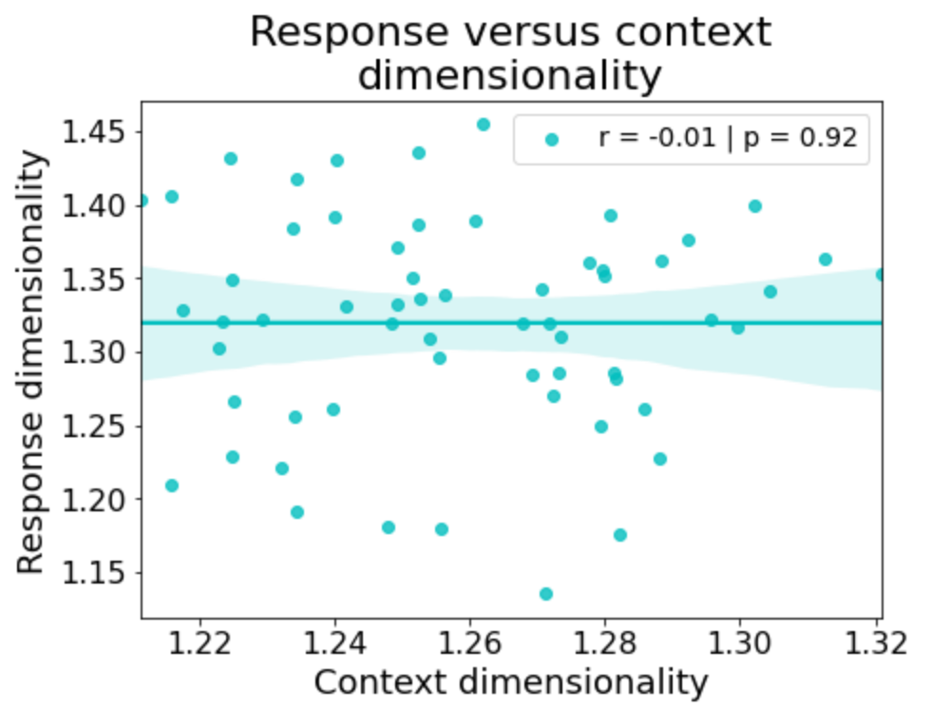
Adam + Pretraining
SGD + Pretraining
Unclear why there is this distinction… though Adam does train much more quickly/efficiently than SGD

Slide 20
Leads to a testable hypothesis in data:
Lower dimensional task context representations
➔
Higher dimensional response representations
In prefrontal areas
Can also evaluate how dimensionality is shaped across each presentation of a new rule

Slide 21
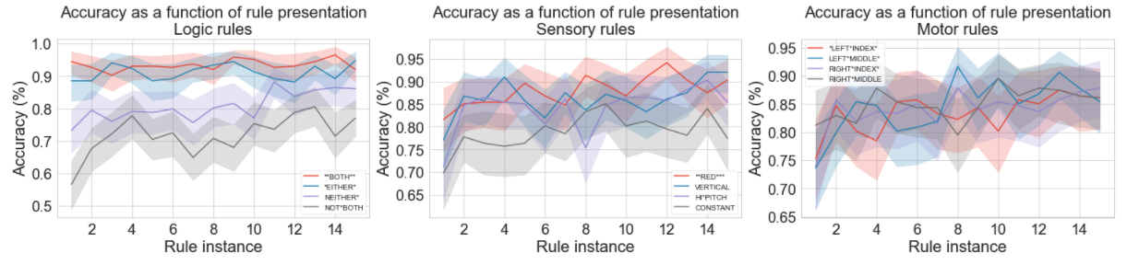
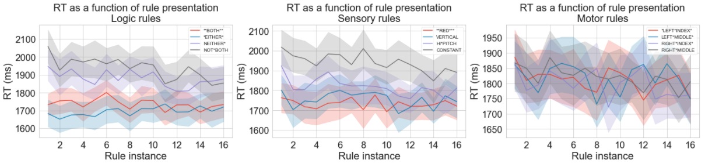
Human behavioral data

Slide 22
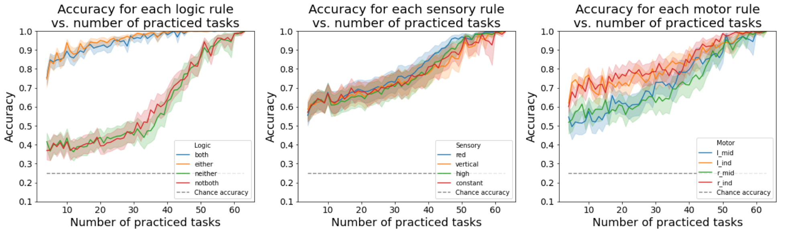
ANN equivalent of by-rule analysis – Adam x pretraining
“both” and ”either” are significantly easier than ”notboth” and “neither”

Slide 23
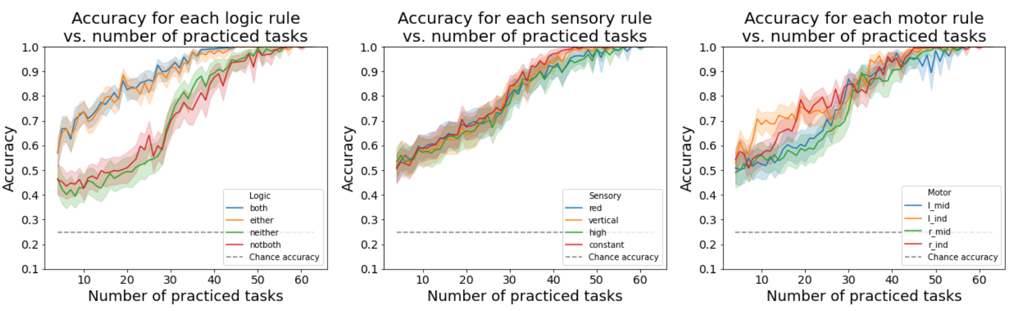
ANN equivalent of by-rule analysis – SGD x pretraining
“both” and ”either” no longer show ”notboth” and “neither”

Slide 24
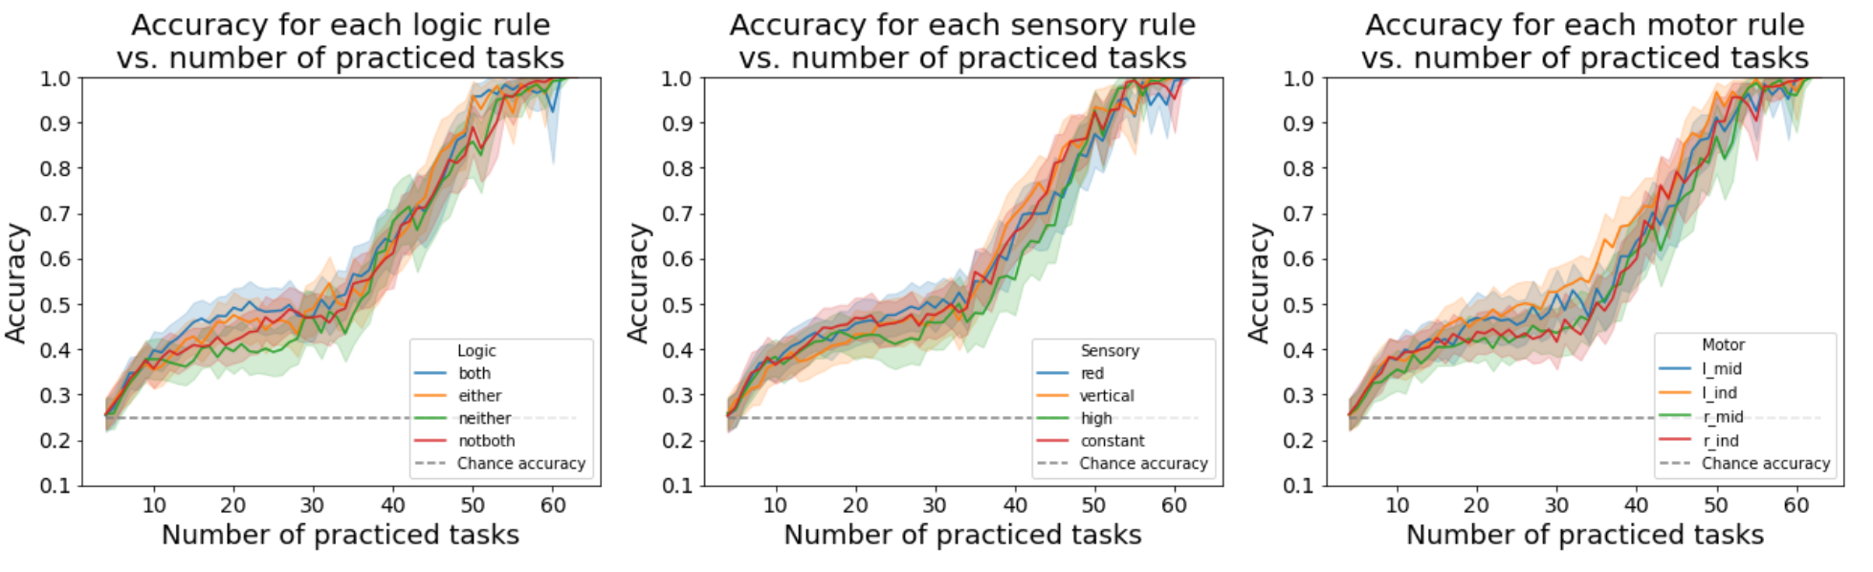
ANN equivalent of by-rule analysis – Adam x no pretraining
Without pretraining, you no longer see this distinction

Slide 25
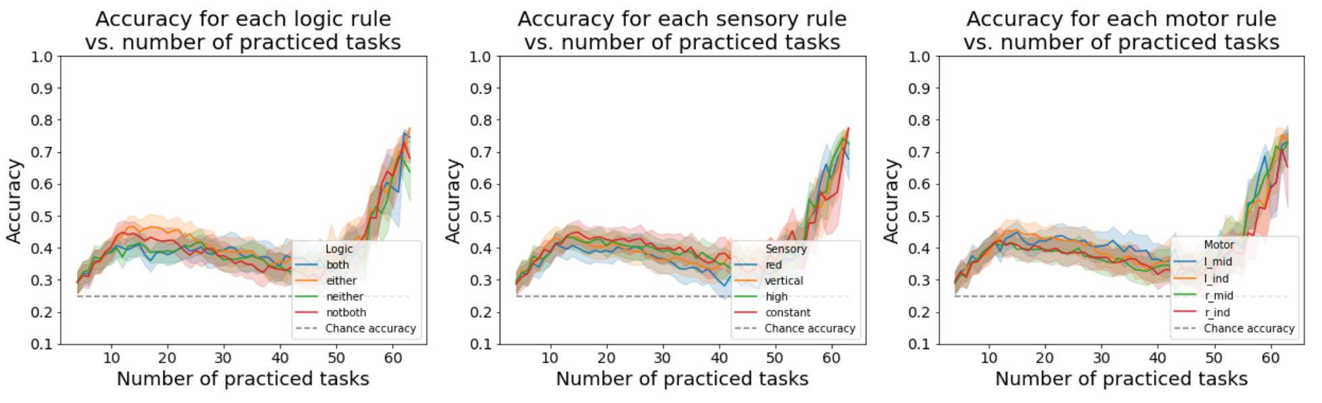
ANN equivalent of by-rule analysis – SGD x no pretraining
Without pretraining, you no longer see this distinction

Slide 26
How are the task rule inputs modeled?
both
either
not
red
vertical
high
constant
lmid
lind
rmid
rind
Logic
Sensory
Motor

Slide 27
How are simple/primitive tasks modeled? Logical-sensory primitive task
both
either
not
red
vertical
high
constant
lmid
lind
rmid
rind
Logic
Sensory
Motor
If EITHER stimulus is VERTICAL, output TRUE; else FALSE
both
either
not
red
vertical
high
constant
lmid
lind
rmid
rind
Logic
Sensory
Motor
If NEITHER stimulus is HIGH, output TRUE; else FALSE

Slide 28
How are simple/primitive tasks modeled? Sensorimotor primitive task
both
either
not
red
vertical
high
constant
lmid
lind
rmid
rind
Logic
Sensory
Motor
If stimulus is VERTICAL, output RMID; else RIND
both
either
not
red
vertical
high
constant
lmid
lind
rmid
rind
Logic
Sensory
Motor
If stimulus is HIGH, output RIND; else RMID

Slide 29
Why are ANNs biased towards affirmative (BOTH & EITHER) rules, rather than negative rules?
Hypothesis – Questions that we pose are inherently biased towards affirmative conditionals
Ex: If RED then press RMID
Observation: Questions can be inherently biased towards negative conditionals, too
Ex: If NOT RED, then press RMID
Hypothesis: Train network only on negative conditionals in the sensorimotor primitive task

Slide 30
Converting affirmative conditionals to negative conditionals in the sensorimotor primitive task
both
either
not
red
vertical
high
constant
lmid
lind
rmid
rind
Logic
Sensory
Motor
If stimulus is NOT VERTICAL, output RMID; else RIND
both
either
not
red
vertical
high
constant
lmid
lind
rmid
rind
Logic
Sensory
Motor
If stimulus is NOT HIGH, output RIND; else RMID

Slide 31
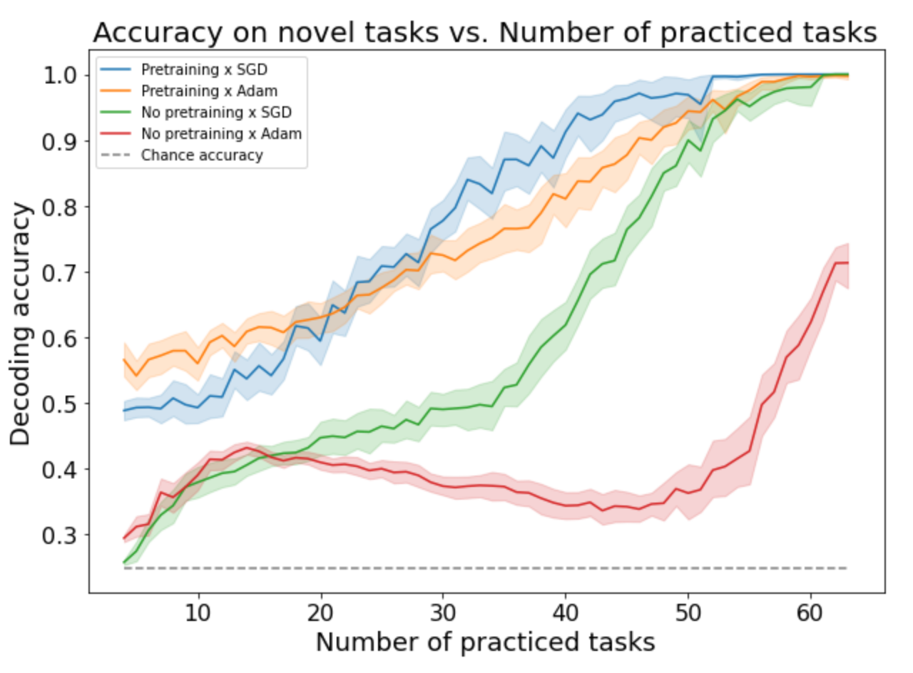
Comparison of networks using pretrained networks on negative sensorimotor tasks
Overall performance patterns are consistent with the standard (affirmative) sensorimotor task

Slide 32
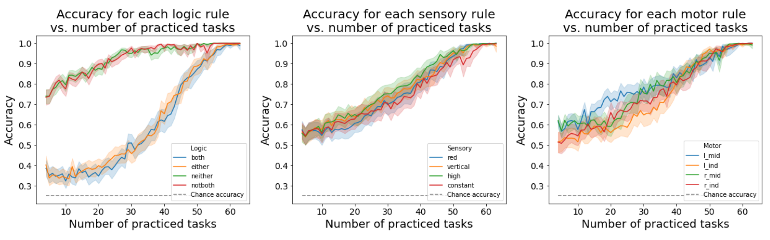
Evaluating task performance by specific rules
Performance on specific logical rules is flipped – rules involving negations outperform ‘affirmative’ rules

Slide 33
Evaluating task performance by specific rules (using Adam)
Performance on specific logical rules is flipped – rules involving negations outperform ‘affirmative’ rules
Results are qualitatively similar with using SGD

Slide 34
What if we pretrained the networks on both affirmative and negative versions of the sensorimotor primitive task?

Slide 35
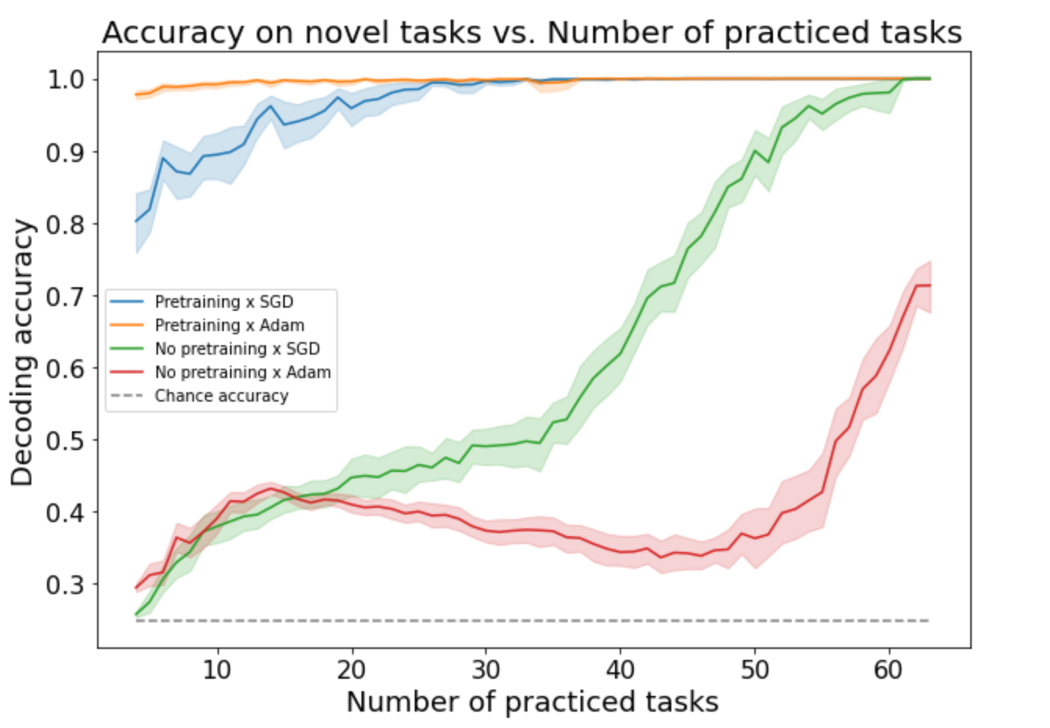
Training on both affirmative + negative sensorimotor primitive tasks yields nearly perfect performance after training on just 4/64 tasks

Slide 36
What about zero-shot learning on the full C-PRO task?
Pretrained tasks have never seen all 3 rules together
Would be a demonstration of systematicity and productivity (extending 2 rule to 3 rule tasks)

Slide 37
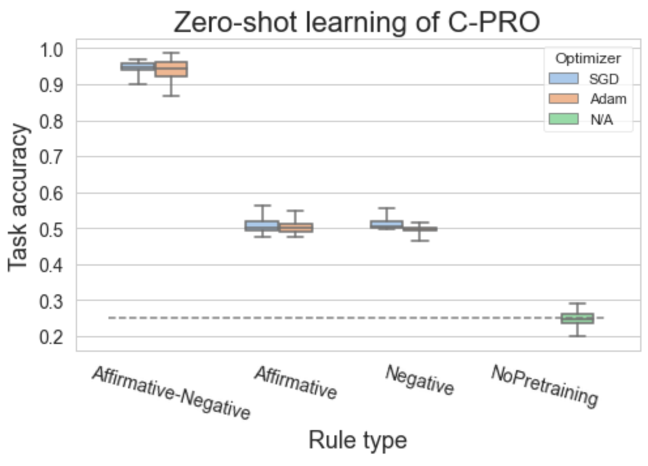
Highly accurate zero-shot learning when training on both affirmative & negative sensorimotor primitive tasks

Slide 38
Same results if ‘not both’ and ’neither’ are encoded separately
both
either
not both
neither
red
vertical
high
constant
lmid
lind
rmid
rind
Logic
Sensory
Motor

Slide 39
Empirical fMRI results
Objective: identify how and where the brain represents compositional information
Previous work has shown that the brain contains compositional representations (Reverberi et al. 2012; Cole et al. 2015)
But what are the computational properties of compositional representations, and why are they useful?

Slide 40
Approach
Identify regions that are sensitive to compositional representations
Test for…
Regions sensitive to novelty (i.e., practiced versus novel tasks), since novelty-sensitive regions are likely involved in flexible re-use of compositions (Cole et al. 2016)
Regions that are sensitive to negations – within Logic rules, we can group NEITHER + NOT BOTH versus EITHER and BOTH
Cross condition generalization performance (CCGP) (Reverberi et al. 2012; Bernardi et al. 2020) – question for Mattia: CCGP with distance-based classification would suggest the clustering of representations?
Parallelism – the degree of ‘abstractedness’ in a brain region (Bernardi et al. 2020)

Slide 41
Novelty results
For each task block (which includes a single task context), label it as either ‘practiced’ or ‘novel’
Run a cross-subject decoding on novel and practiced blocks, testing on held-out subjects (10-fold)
Note that each subject has distinct practiced task contexts they are trained on

Slide 42
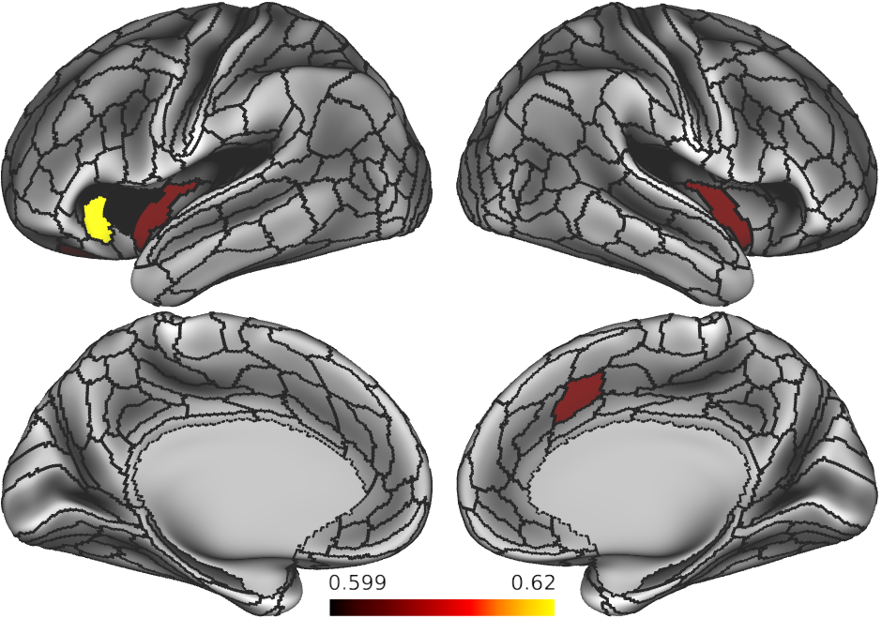
Regions sensitive to novelty?

Slide 43
Regions sensitive to negations
If a brain area represents information compositionally, it should be able to disentangle affirmative conditions (BOTH & EITHER) from negations (NOT BOTH & NEITHER)
This is another form of cross-condition generalization
Cross-subject 10-fold cross validation

Slide 44
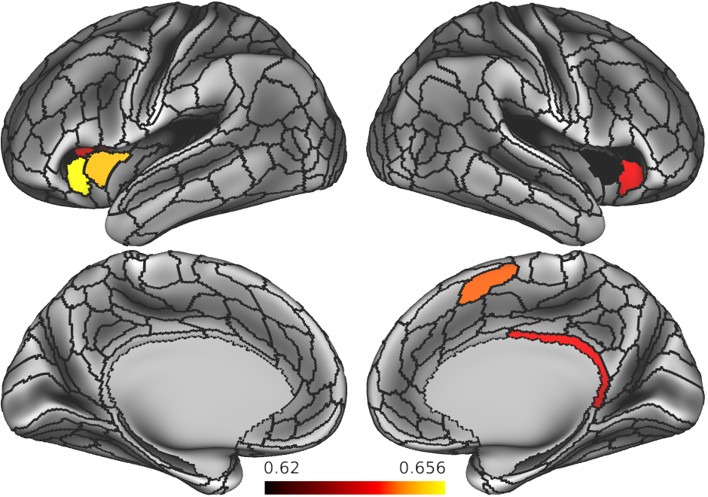
Regions sensitive to negations?

Slide 45
CCGP results
Extract 64 task contexts
For each rule domain decode logic rules (BOTH v EITHER v NOTBOTH v NEITHER)
By definition, since there’s only one sample per task context, this is CCG

Slide 46
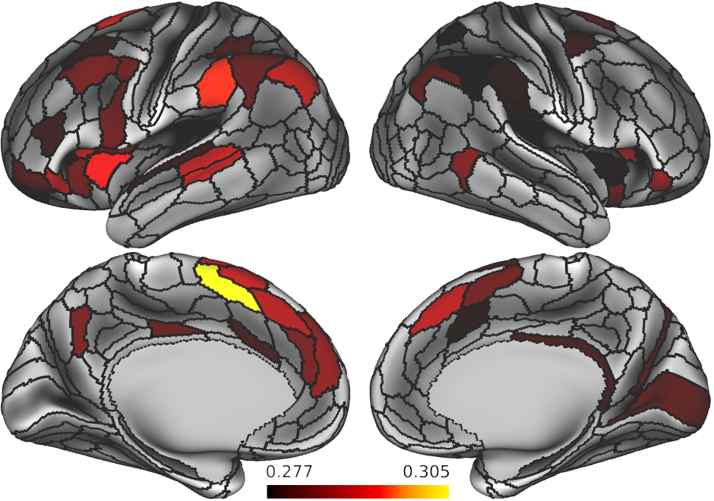
Logic rule CCGP – statistical significance assessed using alpha<0.05 on shuffled data

Slide 47
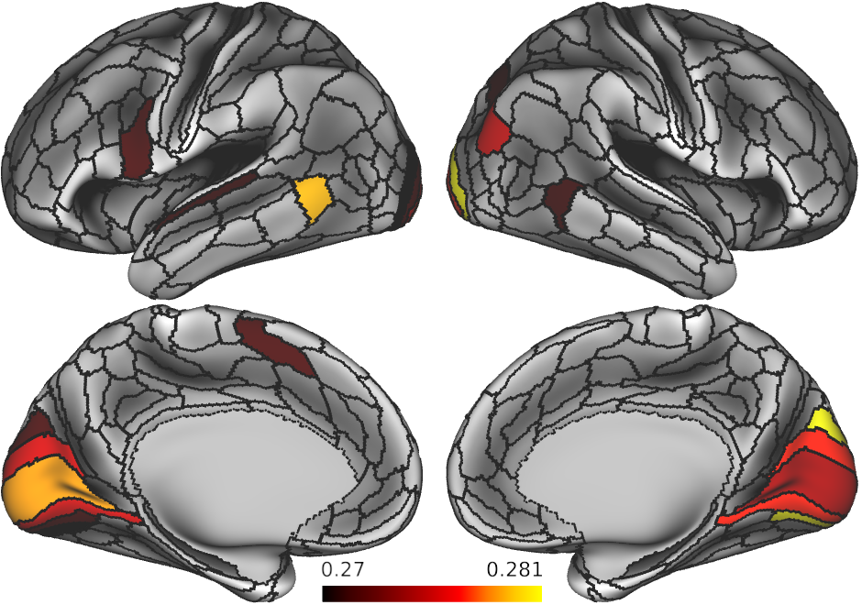
Logic rule CCGP – statistical significance assessed using alpha<0.05 on shuffled data

Slide 48
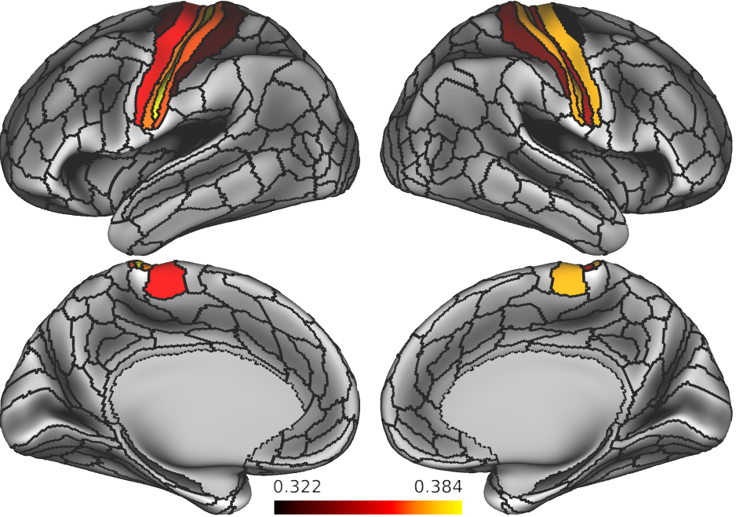
Motor rule CCGP – statistical significance assessed using alpha<0.05 on shuffled data

Slide 49
Parallelism results
Extract 64 task contexts
For each rule domain compute the degree of parallelism between each pair of rules across contexts
Ex, to test compositionality and coding directions of BOTH and EITHER rules, test if the following 2 vectors are parallel
VECTOR1: BOTH – RED – LMID → EITHER – RED – LMID
VECTOR2: BOTH – VERTICAL – RMID → EITHER – VERTICAL – RMID

Slide 50
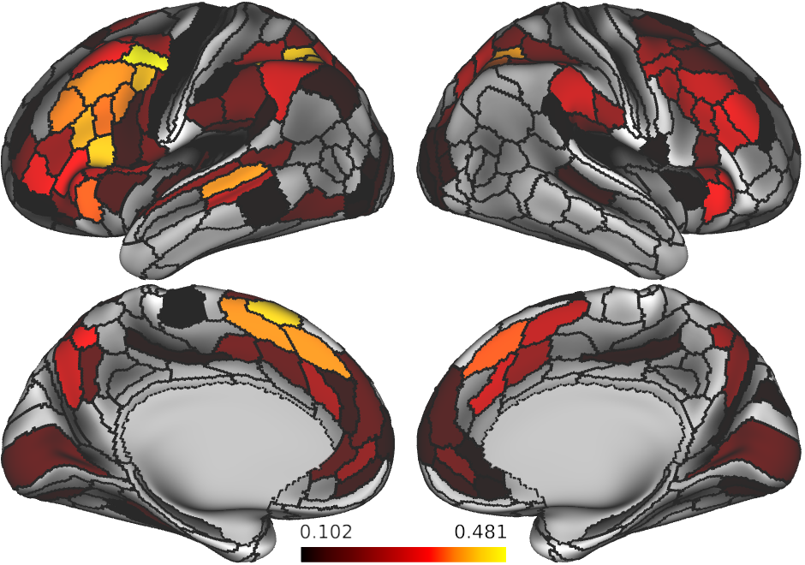
Logic rule parallelism – statistical significance assessed using alpha<0.05 on shuffled data
Question for Mattia -- has he ever experienced negative angles?
Presumably statistical tests should always be performed on |cos x|, no?

Slide 51
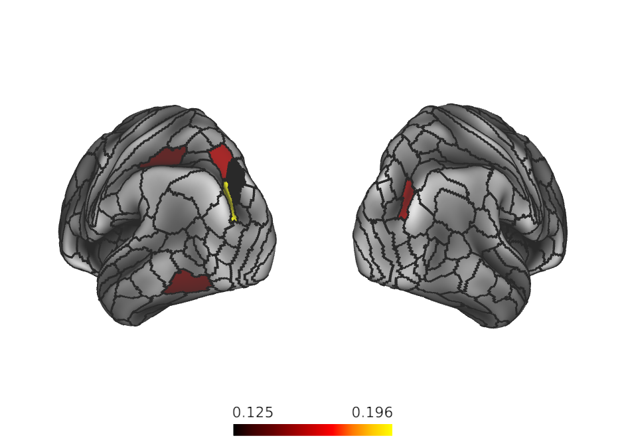
Sensory rule parallelism – statistical significance assessed using alpha<0.05 on shuffled data

Slide 52
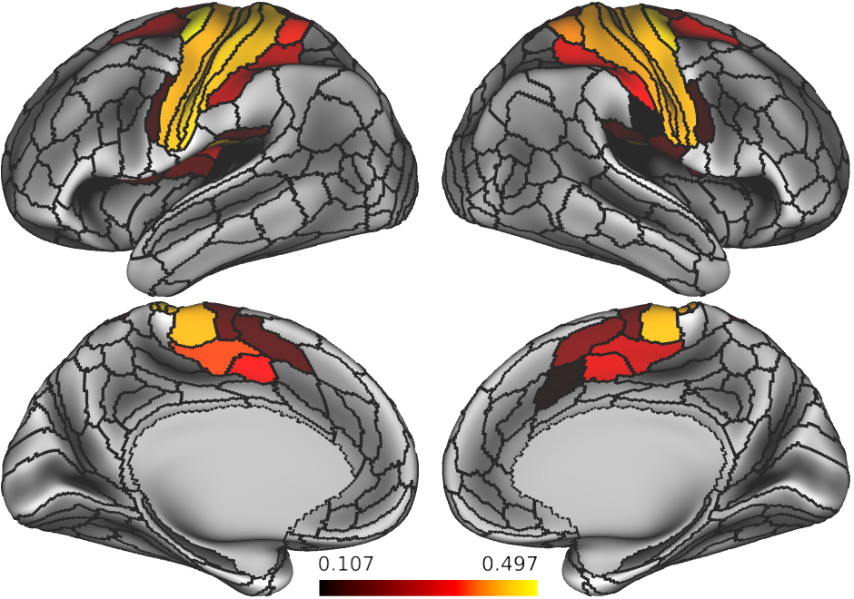
Motor rule parallelism – statistical significance assessed using alpha<0.05 on shuffled data

Slide 53
Measure abstractedness using parallelism score
BOTH
RED
LMID
BOTH
VERTICAL
RMID
a₂
b₂
A
B
a₁
b₁
EITHER
RED
LMID
EITHER
VERTICAL
RMID
Objective: Compute the angle between A and B, where
A = a₂ – a₁
PS = mean {||A|| • ||B||}
for every possible BOTH v. EITHER combination
B = b₂ – b₁

Slide 54
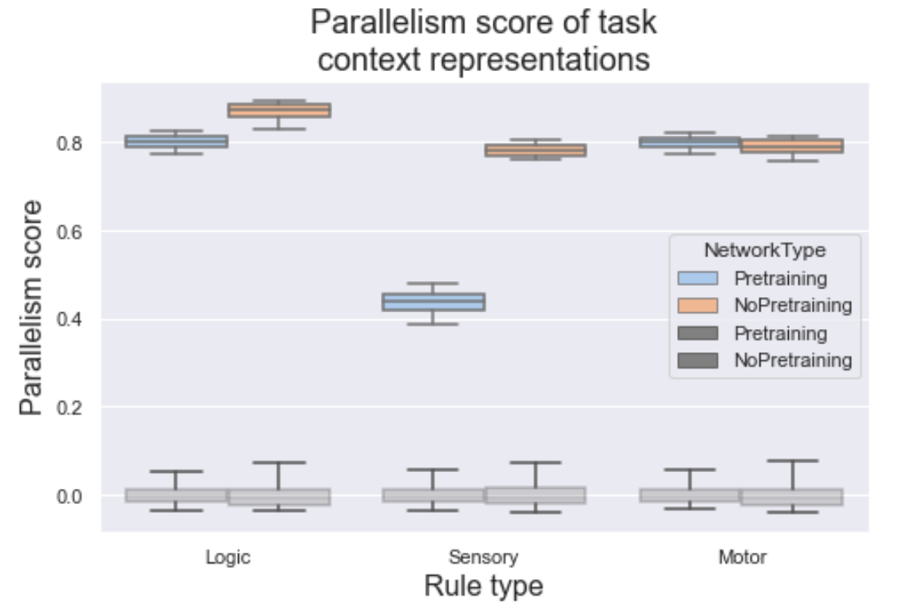
Measure abstractedness using parallelism score

Slide 55
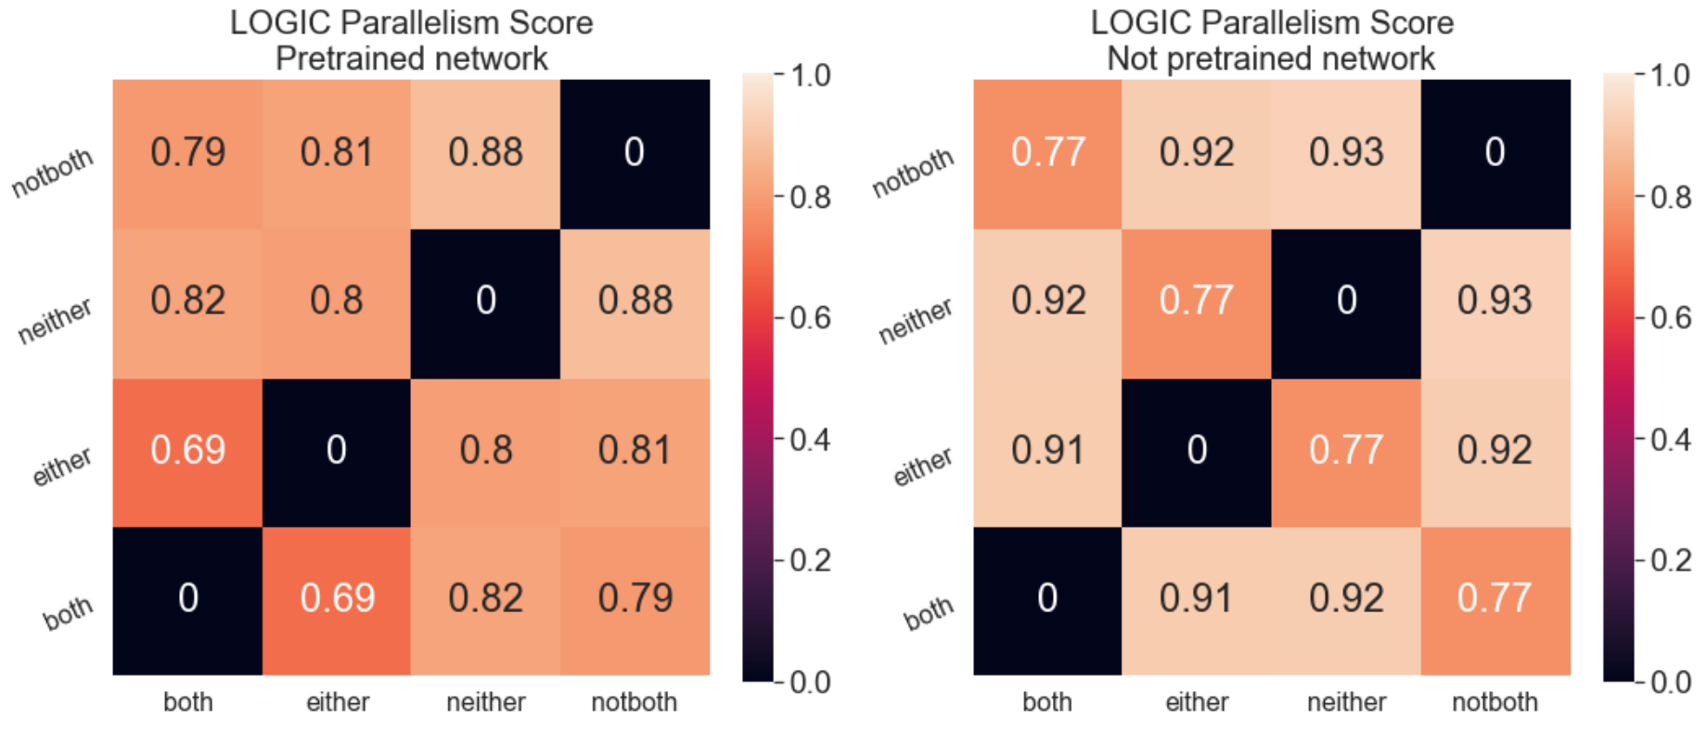
Logic specific cosine angles

Slide 56
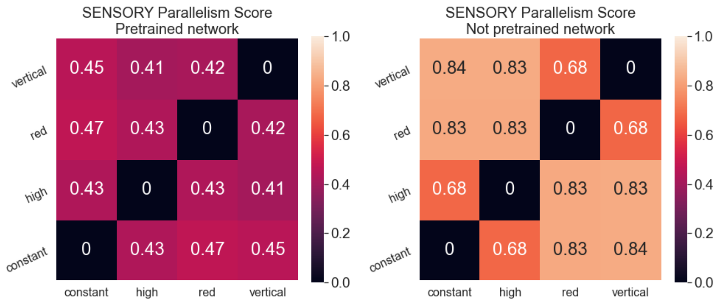
Sensory specific cosine angles

Slide 57
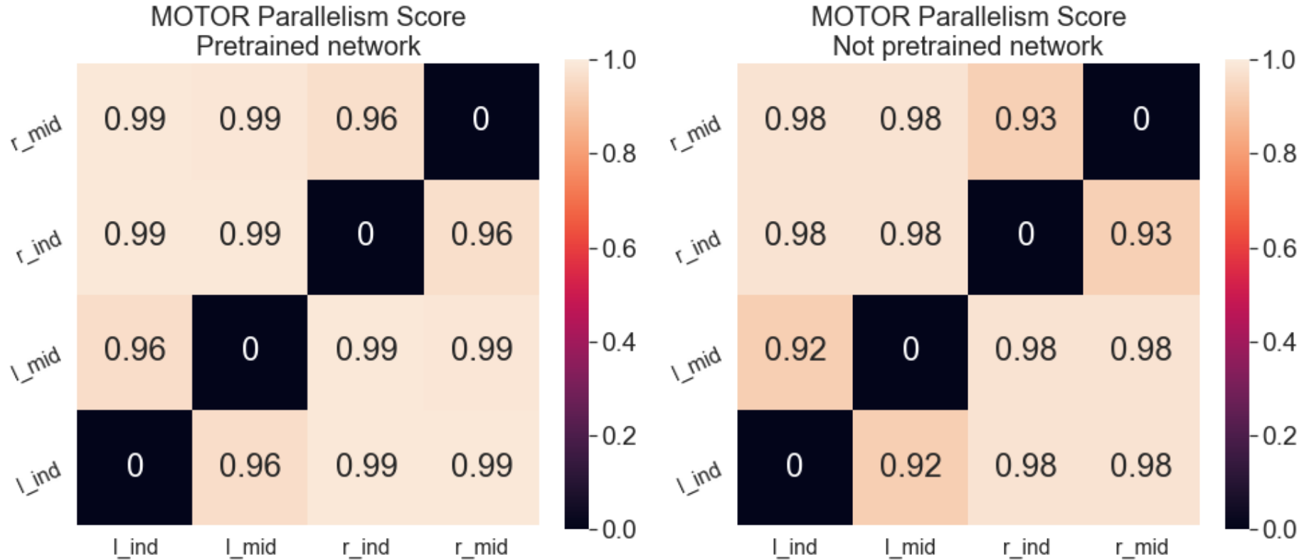
Motor specific cosine angles

Slide 58
Different set of figures from previous project

Slide 59
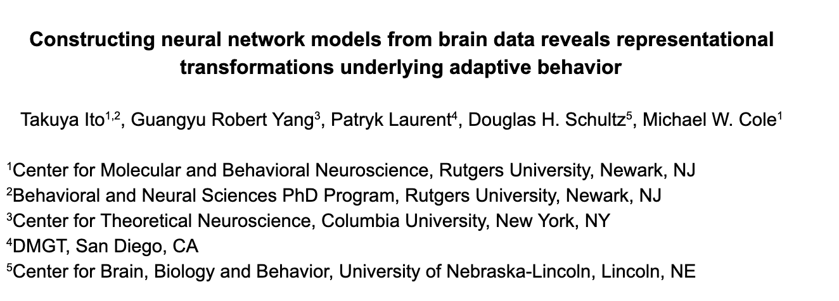
Constructing ANNs from neural data to perform a compositional task

Slide 60
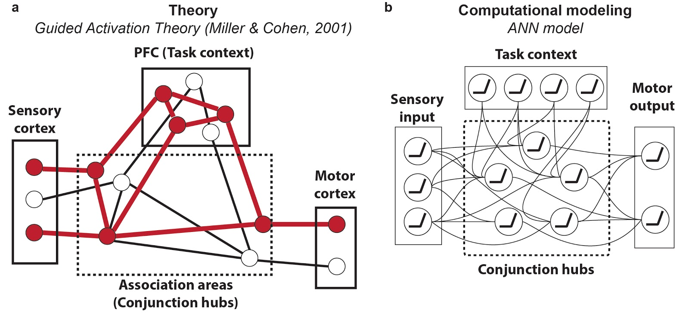
Using psychological theory and ANNs to inspire models of cognitive computations from data

Slide 61
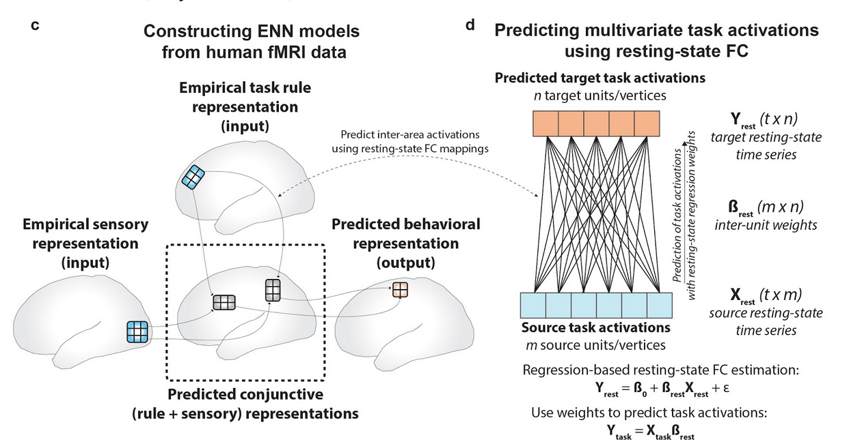
Constructing ENNs (empirical NNs) from data to characterize cognitive computations

Slide 62
Task – Concrete Permuted Rule Operations (C-PRO)

Slide 63
Identifying representational changes in ANNs to match to brain data

Slide 64
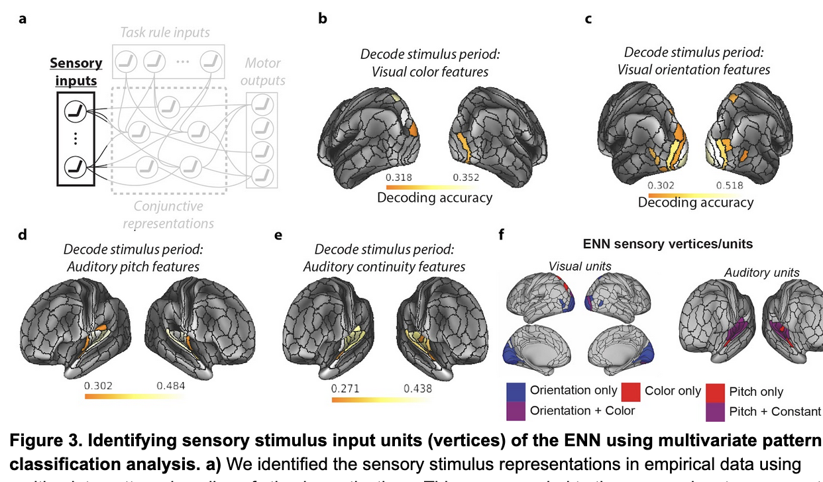
Identifying task-relevant brain areas: Sensory regions

Slide 65
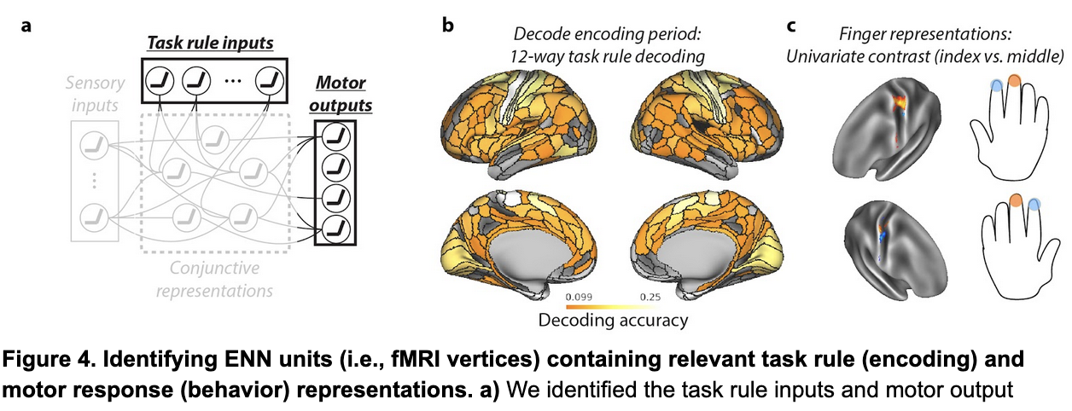
Identifying task-relevant brain areas: Rule-representing and motor regions

Slide 66
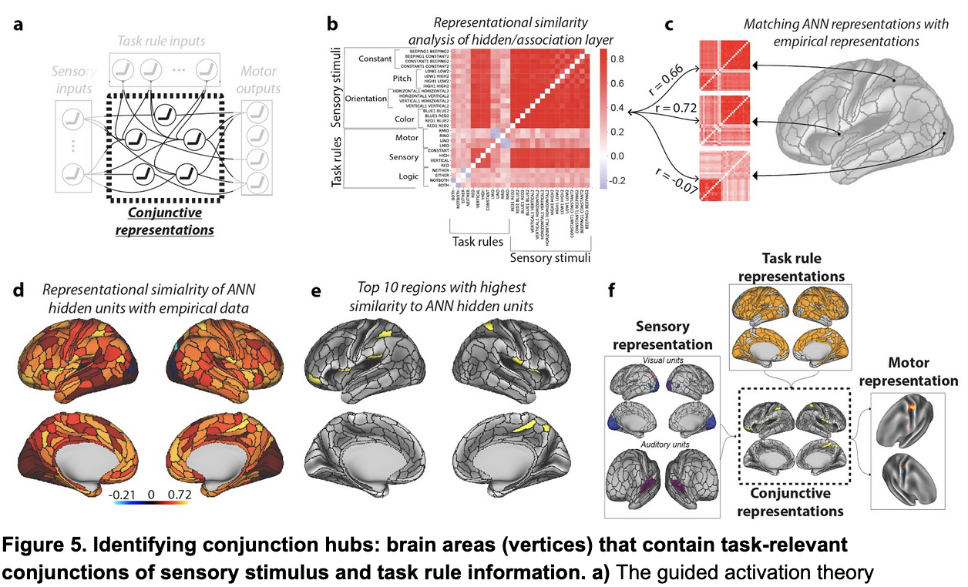
Identifying task-relevant brain areas: hidden/conjunctive regions

Slide 67
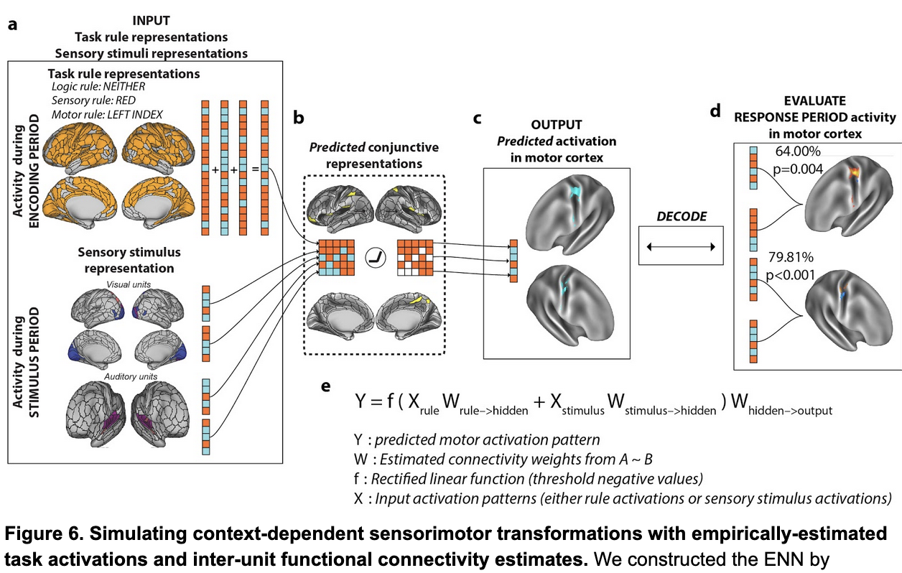
Simulating neural network computations using fMRI brain data

Slide 68
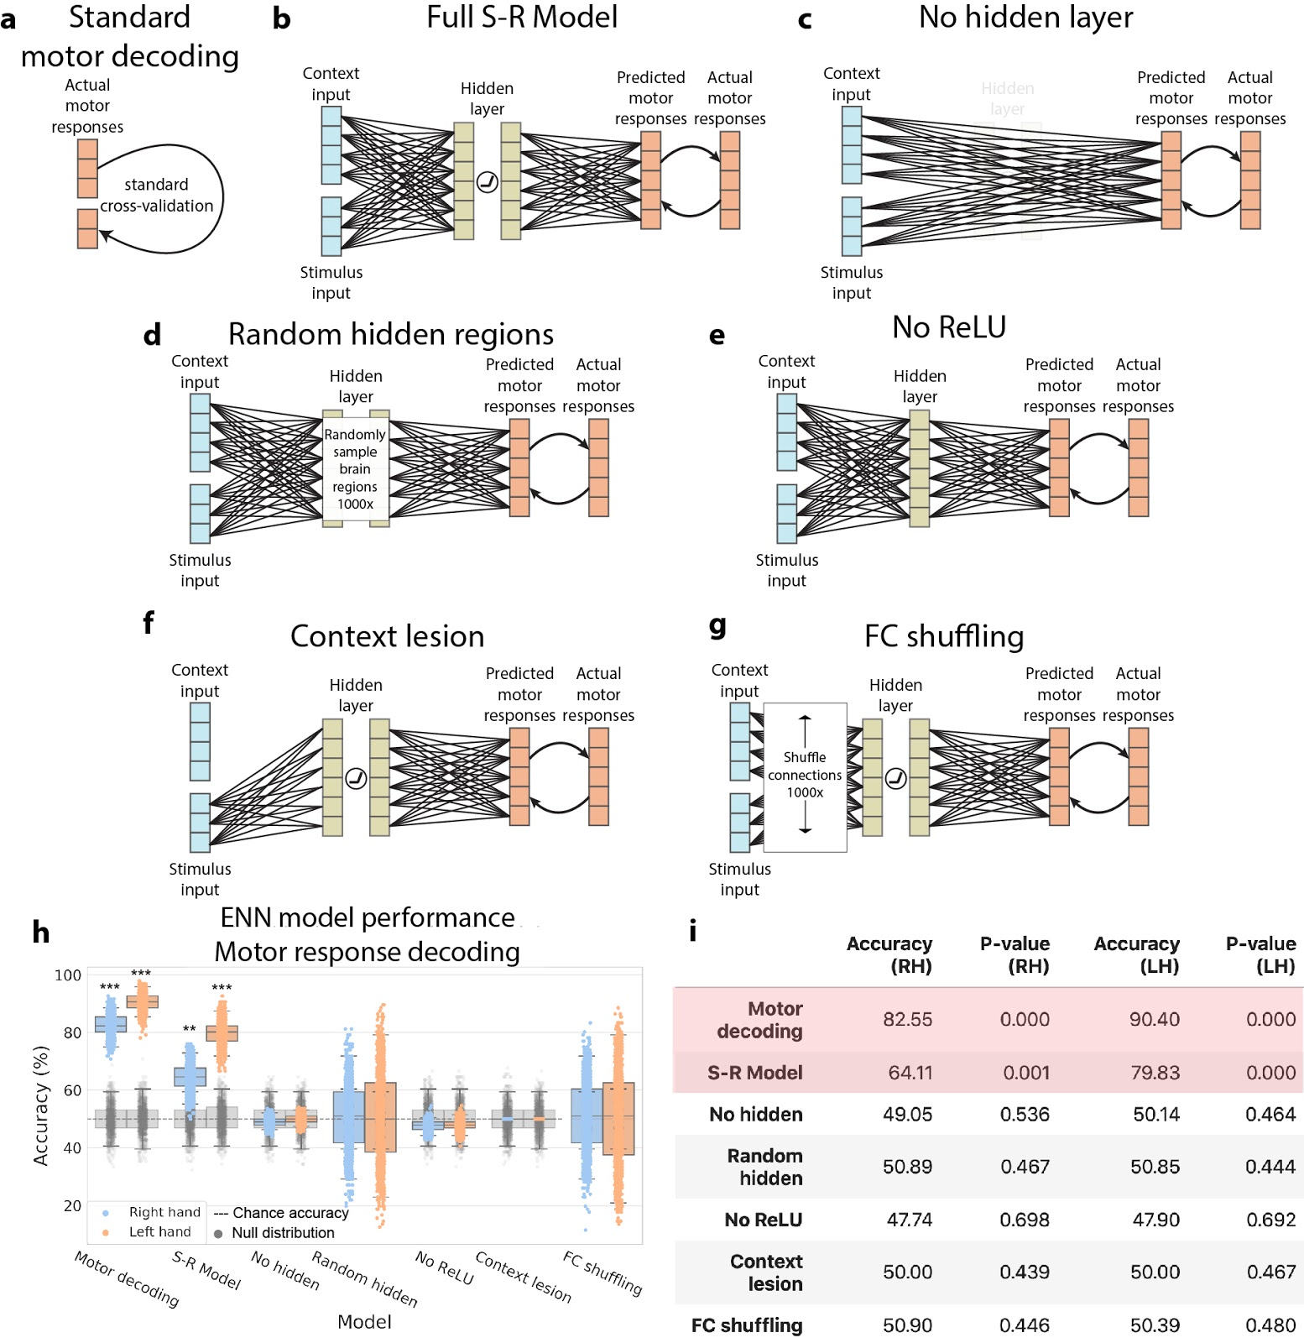
Systematic alteration of ENN model architecture verifies validity of “full S-R model” results

Slide 69
Systematic alteration of ENN model architecture verifies validity of “full S-R model” results

